Slide 1
ETRSS-1 Vibration Environment and Test of Satellite
DFH SATELLITE CO.,LTD
February.2019

Slide 2
Vibration environment and test of satellite
Course &Teacher Introduction
Discipline:
1) respect each other. Don’t disturb the others.
2) take the exercise as much as possible, and ask if you have question.
Our goal :
1) what is Vibration and Vibration test
2) how to perform a Vibration test .

Slide 3
Vibration environment and test of satellite
Content
Satellite vibration environment introduction
vibration test
The facility of vibration test
vibration test attention
Notching criterion
Review

Slide 4
Satellite vibration environment introduction
In life cycle of a spacecraft, there are all kinds of dynamic environment. Dynamic environments include all phenomena that produce fluctuating excitations (also called forcing functions or dynamic loads) that act on a spacecraft and/or its constituent components. The excitations may occur physically as either an applied force or an input motion, and may be either internally or externally induced.

Slide 5
Satellite vibration environment introduction
Internal Environments
(a) imbalance of rotating parts;
(b) operation of mechanisms;
(c) coupling misalignment in the assembly of hardware;
(d) magnetic, aero- or hydrodynamic forces within the unit;
(e) sloshing of liquid propellants in tanks;
(f) torque variations due to an uneven supply or demand of power.

Slide 6
Satellite vibration environment introduction
External Environments
(a) Transportation;
(b) Seismic Loads During Pre-Launch;
(c) Wind and Turbulence;
(d) Rocket Motor Ignition Overpressure;
(e) Liftoff Release Loads;
(f) Engine/Motor Generated Acoustic Loads;
(g) Stage and Fairing Separation Loads.

Slide 7
vibration test
As we all know, these kinds of dynamic environment is hard to simulate directly, therefore, we must summarize all dynamic environment into some type of excitation, and predict the response of spacecraft. As one of large environmental test series after assembly and integration of satellite, vibration test is one of the most important part of reliability validation tests for satellite.
The vibration test is a method to simulate the real vibration environment of launching process. The vibration test is one of most effective methods to disclose the potential trouble. Indicated by the trouble statistic data of NASA from 57 satellites in the first day after launch, 44 percent of trouble were induced by the vibration environment.
Therefore, a launching satellite must be verified by a vibration test as whole spacecraft according to present production mode.

Slide 8
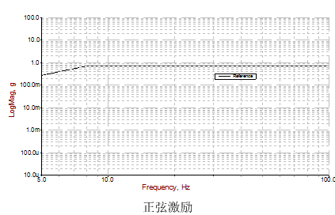
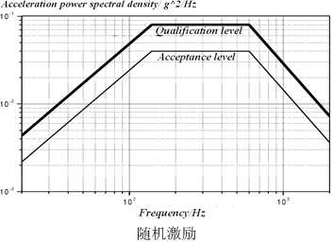
vibration test
Vibration test is generally composed of swept-sine vibration test and random vibration test. Swept-Sine vibration test is used to simulate Transients, Such as motor ignition overpressure and the liftoff release, which will cause the Transients excitation. Random vibration test is used to simulate high frequency vibration caused by aeroacoustic excitations.

Slide 9
The facility of vibration test
Test facility
we have introduced the vibration environment and vibration test, now we will discuss the facility of vibration test. It include two system, the one is vibration inspiring system,which contains shaker、controller for shaker、power amplifier for controller、acceleration sensors for control、charge amplifier for sensors；the other is measure system, which contains data acquirer and analyzer、acceleration sensors、dynamic signal conditioner、strain sensors、strain amplifier.
Vibration inspiring system | Measure system
Shaker | Data acquirer and analyzer
Controller for shaker | Acceleration sensors
Power amplifier for controller | Dynamic signal conditioner
Acceleration sensors for control | Strain sensors
Charge amplifier for sensors | Strain amplifier

Slide 10
The facility of vibration test
Test facility
Shaker introduction
The shaker is an electro-dynamic force generator, in which an alternating force is created by an alternating current carrying conductor operating in a properly oriented direct current generated magnetic field.
Shaker body can be rotated between vertical and horizontal direction. So Satellite fixed on shaker can be tested in three axes.

Slide 11
The facility of vibration test
Test facility
Shaker introduction
satellite is fixed on the expander connected to shaker body. We define this direction X. satellite can be tested in this direction X
satellite
Shaker

Slide 12
The facility of vibration test
Test facility
Shaker introduction
beside, satellite can be tested in other directions called Y、Z. In these directions satellite should be fixed on the slip table connected to shaker body.
Above all, we can get the satellite should be tested in three directions.
how the vibration inspiring system work?
satellite
Shaker
Slip table

Slide 13
The facility of vibration test
Test facility
Vibration inspiring system
Acceleration sensors are installed on the interface between satellite and shaker. Controller generates the drive signal. The signal is inputted into shaker after amplified. Then shaker vibrates. Vibration response signals caught by sensors are fed back to controller. Drive signal is rectified in accord with the condition.
satellite
Charge amplifier
Acceleration
Sensors
Vibration controller
Shaker
Power amplifier

Slide 14
The facility of vibration test
Test facility
Measure System
this page show how the measure system work.
This picture is response data flow. acceleration sensors( strain sensors) are installed at concerned positions of satellite structure. Vibration response signal caught by sensors and amplifier are acquired and analyzed.
Acceleration sensors
（Strain sensors）
satellite
Dynamic signal conditioner
(Strain amplifier)
Shaker
Data acquirer and analyzer

Slide 15
vibration test attention
From this page we will talk about test design preparation and implementation. Firstly, vibration test design will be discusseded. It includes：test objective、technical status、Test field requirements、test flow、the hoisting and assembly requirments in test、interruption and trouble cleaning policy in test、succeeding criterion of test、safety requirements of test.

Slide 16
vibration test attention
Test objective as following：
Demonstrate the capability of satellite to withstand acceptance vibration and acoustic environment .
Disclose the potential failures of materials, components and manufacture technology.
Acquire the response data that can validate the expected vibration requirement.
Check the units that can’t undergoing unit-level vibration test separately.

Slide 17
vibration test attention
TECHNICAL STATUS
Satellite coordinate and quadrant——decides the direction of test
main parameter-----dimension
1)Satellite body dimension;
2)Launching dimension;
3)Satellite-rocket interface;
4)Principium analysis for the whole mass property（such as center of mass and
center of mass inertia）;
Main technical state
1)All the product on the satellite should be flight module;
2)The thermal control of the satellite is complete;
3)All vibration sensors have been installed;
4)The whole satellite is implemented the grounding.

Slide 18
vibration test attention
TEST FIELD REQUIREMENTS
Test field should meet the lifting, parking, handling space;
Test field should meet the requirement of the satellite test on the ground;
Field environment requirement:
Air cleanliness: class 100000;
Temperature: 15°C～25°C;
Relative humidity: 30%～60%;
There are no articles of irrelevant test;
The person who will enter testing field should pull on special clothing, accept air shower, and observe requirements of the test field and environment protection.

Slide 19
vibration test attention
TESTING FLOW
Before test we must know the test flow. The test sequence should be Sine first, and then random test. In each direction, the test level should be characteristic level, sine acceptance level, random acceptance level, characteristic level. The mechanic test flow is following:

Slide 20
vibration test attention
THE HOISTING AND ASSEMBLY REQUIRMENTS IN TEST
When the test is implied, the hoisting and assembly is the inevitable part. In these part we should notice these point:
Pay attention to the equipments on the satellite in the hoisting, and avoid colliding with other items , ensuring product safety;
Keep the satellite clean without pollution during the operation.

Slide 21
vibration test attention
INTERRUPTION AND TROUBLE CLEANING POLICY IN TEST
Before the test implying, we must predict all things that will happen possibly, especially the interruption and trouble in test. now we will talk about the policy on it.
All failure and abnormalism found in the test should be on record, if necessary, we should protect the testing field;
We should stop the test and eliminate failure and abnormalism of equipments which are found in the test, and other situations are on-site treatment;
If reproduce the failure and abnormalism found in the test, we permit reloading in the characteristic dimension, but it should be agreed with satellite system;
If there is abnormal sound in the test and response characteristics change obviously, we should stop testing immediately.

Slide 22
vibration test attention
SUCCEEDING CRITERION OF TEST
When test is finished, How can we know whether the test is success? so the success criterion of test must be known by us.
The appearance of the satellite is checked normal;
The characteristic measuring response curve must be accordant before and after each direction of the Sine and Random vibration acceptance test;
After the testing, solar array could deploy, solar cells keep the electric property;
The results of satellite accurate measurement are within the scope specified before and after the testing.

Slide 23
vibration test attention
SAFETY REQUIREMENTS OF TEST
The safety of test is a key point which can be ignored easily. so I think we should talk about it. Before test, we must emphasize the following points:
All the lab assistants must obey the technique and safety rules strictly;
Testing field, electrical source, initiating explosive devices and measuring equipment should be checked on before the test;
On-site electrical source must be taken charge of by the specific person;
The person in charge of pyrotechnic devices must monitor their state on test. There are isolation belts around the satellite , which can make sure of personal safety of the model team;
Using a variety of instruments and meters should be strictly followed the rules and operations, illegal operation is strictly prohibited.

Slide 24
Notching criterion
Terms, Definitions and Abbreviated Terms
The vibration test have many links, although every part is important, the establishment of test condition is the key point, which decides whether the test is effective and succeed. Now we will discuss the establishment method of test condition that is notching criterion. before discussing this part, we must know some definition and terms.

Slide 25
Notching criterion
Terms, Definitions and Abbreviated Terms
Firstly It’s acceptance level test, Acceptance tests are conducted to demonstrate satisfactory performance of flight systems relative to the expected environment and to reveal inadequacies in workmanship and material integrity. It’s abbreviated to AT.
Second It’s flight model, which is abbreviated to FM. It can be understood easily, satellite’s function status is the same as flight model.
The third one is launch vehicle which is abbreviated to LV.
Finally Spacecraft、satellite can be abbreviated to SC.

Slide 26
Notching criterion
In this segment, we must determinate appropriate input curve, the curve may be adjusted in some specific frequencies according to the test data. now we will talk about the notching criterion for sdjusting the input curve.
Notching criterion :
Input curve must be higher than the prediction curve provided by LV.
Input curve must satisfy that the response of all units on SC are lower than their response in unit acceptance test.

Slide 27
Notching criterion
Now we will explain these criterions through an example. Let’s see this picture, It’s X axis swept-sine vibration test, input curve without notching.

Slide 28
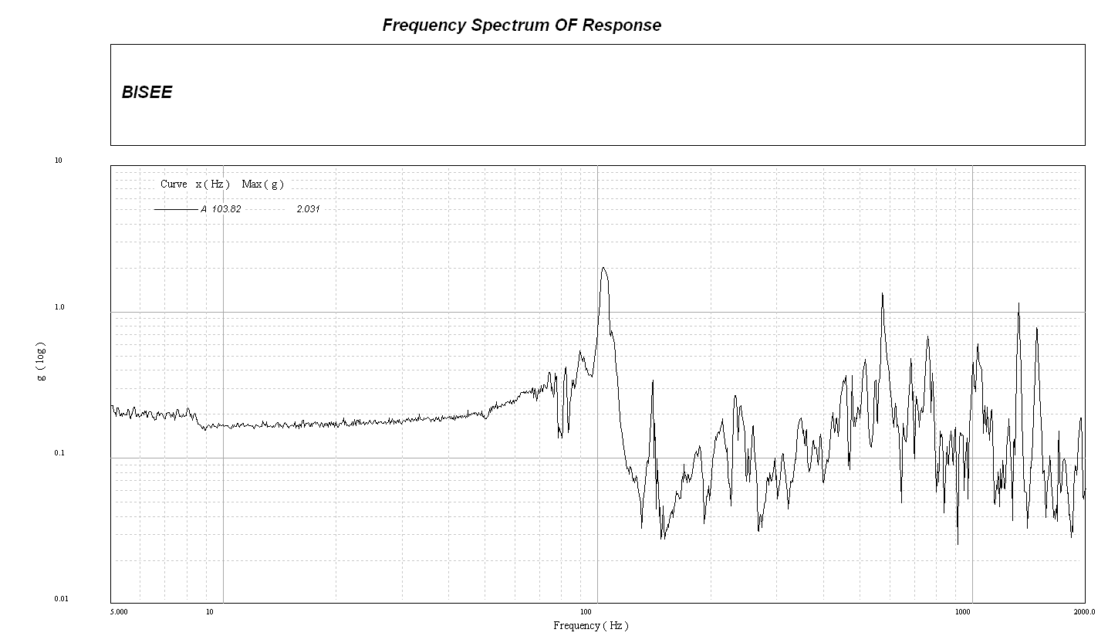
Notching criterion
Then we get response data of all units after we finished the x-axis low level sine-swept test. this picture is one of the units’response in SC.

Slide 29
Notching criterion
Detailed Process
Firstly, we need check all response data of units on SC in low level test , and find out the units whose response are larger than 1g.
Then, we can predict the response of these units in acceptance test by comparing the low level and AT curve without notching. If the prediction is larger than the response in units acceptance test, we must notch the AT curve in the related frequencies to protect the units.
However, notching is not unlimited, the curve with notching must be higher than the prediction curve provided by LV.

Slide 30
Notching criterion
Test method
In satellite vibration test, the response of earth-sensing device in X-axis low level test is 2.5g at 95Hz, low level test’s input of SC is 0.15g.
it can be inferred that this device will reach 11.7g if the input of SC is 0.7g without notching.
This is larger than 8g(the unit acceptance level), so we need adjust the input value to 0.48g around 95Hz .
The same analyses can be processed for all other units.

Slide 31
Notching criterion
Test method
We collect all value and frequencies that need notch, and summary these statistic data. Then, we need compare these statistic data with the prediction curve by LV.

Slide 32
Notching criterion
Test method
After all units’ responses in SC are analyzed, we can get the real input curve for x-axis AT test of SC. Look at the curve.

Slide 33
Review
Now the content we have discussed is over. there are some questions to verify how much you have learned, please write on your paper.
First one, In life cycle of a spacecraft, what kinds of dynamic environment will the satellite experience? please give three examples each including internal and external environment,
Second one, which kinds of experiments are included in vibration test?
Third one, what kinds of experimental equipment do we need when we conduct vibration test?
Fourth one, Please describe the vibration test process?
Last one, Please describe the notching criterion?

Slide 34
Dynamic environments of satellite
Thank you!

